Slide 1
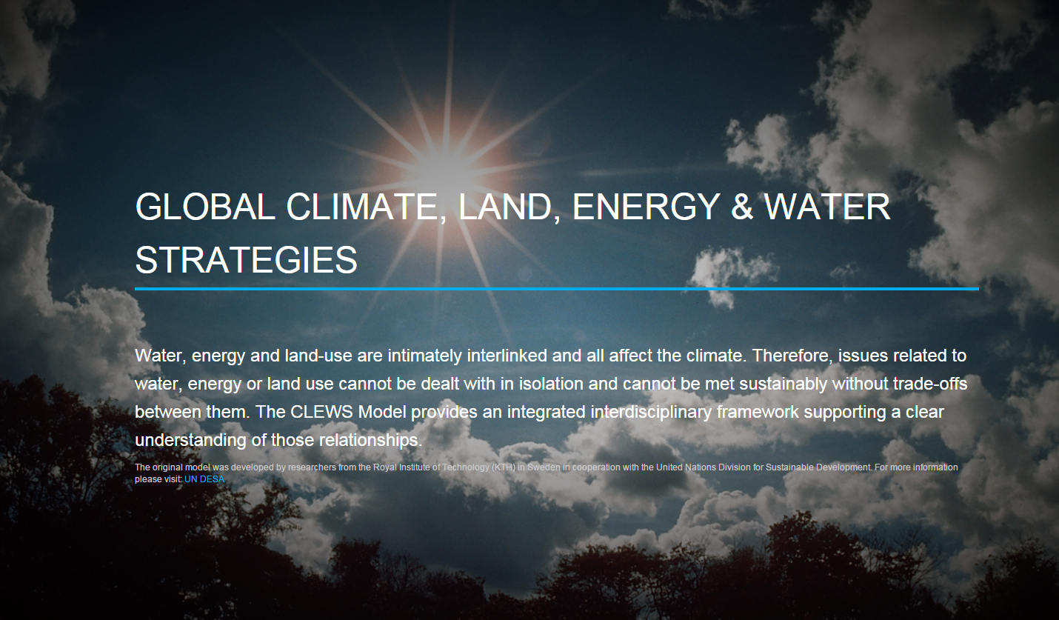


Slide 2
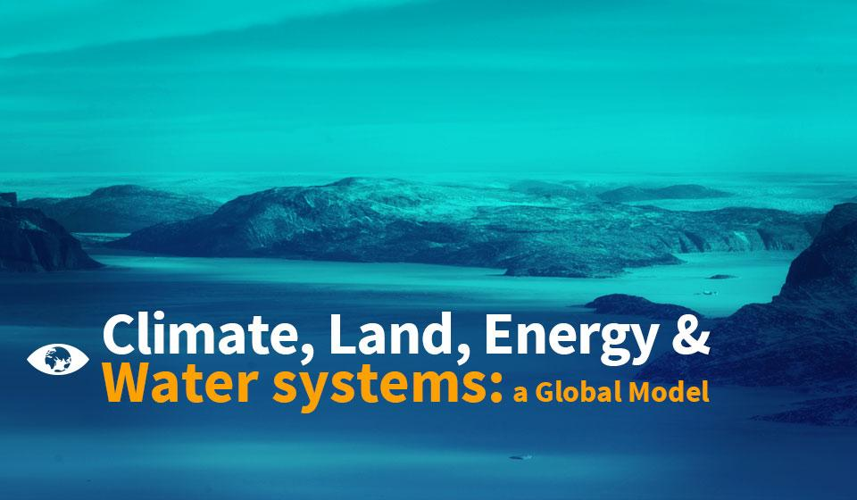

Slide 3

Global CLEWS: objectives
Identify and quantify the interlinkages among climate, land, energy and water at a global scale.
Insights on sustainability trade-offs and synergies of alternative global development scenarios.
Demonstrate how integrated assessment models arrive at results.
Provide national sustainable development policy decision-making with contextual global evidence on sustainability.

Slide 4
Global CLEWS model
The model helps explore questions such as:
What is the role of nuclear, coal and biofuels in a sustainable development path?
What could be the effect of a carbon tax on an optimal allocation of energy mix? And on water consumption?
What would be the global cost of different climate mitigation strategies?
How much stress on water resources arises from different development scenarios?

Slide 5
An integrated assessment model: the global CLEWS
Basic idea: land, energy and water systems are highly integrated. Any assessment of these resources should ideally treat them as such.
Allows for integrated assessment of the food-energy-water nexus.
Enables evaluation of the general robustness of a particular strategy or policy with respect to risks of climate change.
Land
Energy
Water
Climate
Climate

Slide 6
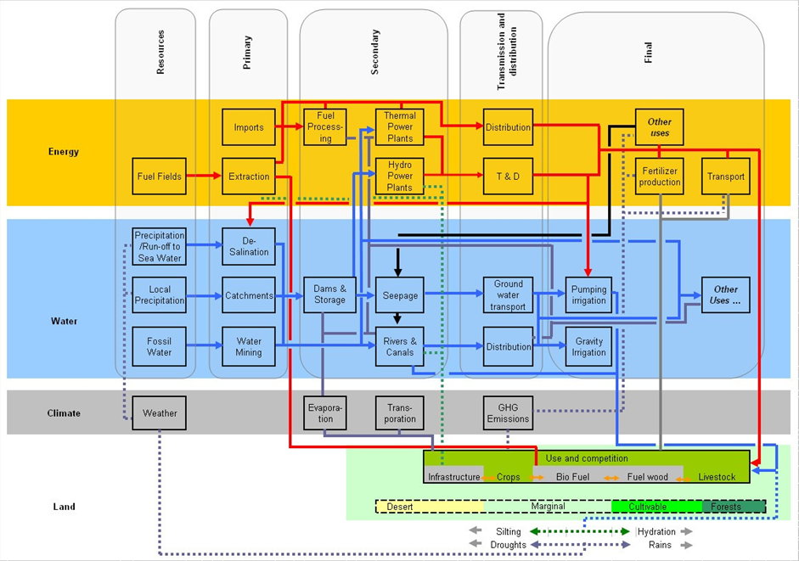
A typical CLEWS diagram describing inter-linkages
Notes:
The figure shows a typical aggregate CLEWS system and interactions among different modules. Technologies and energy/water flows are represented throughout the system to show the key interconnections between processes and resources.
Climate change aspects can act as inputs influencing key processes (e.g., hydropower generation, demand for irrigation) or as outputs (e.g., greenhouse gas emissions).

Slide 7

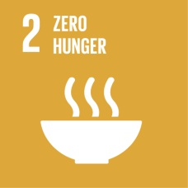
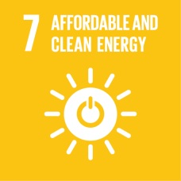
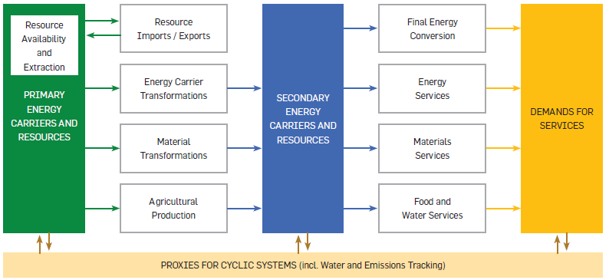

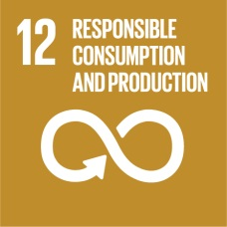
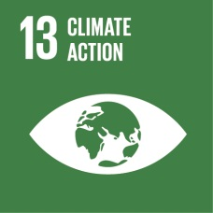

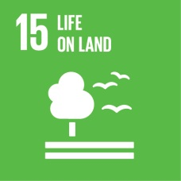
Linking with the 2030 Agenda
Increased income, energy use and material consumption
Demand for food
Demand and source of energy
Industrial production
Assess alternative technologies and consumption patterns
Technology and investment options
Account for carbon emissions
Deforestation and land use

Slide 8
The model: integrated systems
Primary energy sources (e.g., coal, gas, oil, wind, nuclear, hydro, geothermal, biomass) are extracted and/or made available and transformed into secondary energy carriers and resources.
Energy is used by households and industries (e.g., heat, motion, light).
Land uses energy and water through irrigation and fertilizers to produce food to meet global demand and provide biomass for energy.
Industries use energy and materials to produce cement, aluminum, fertilizers, steel, paper and pulp, and petrochemicals to meet global demand.
Use of carbon-based fuels in energy, land and materials sectors results in CO2 emissions.

Slide 9
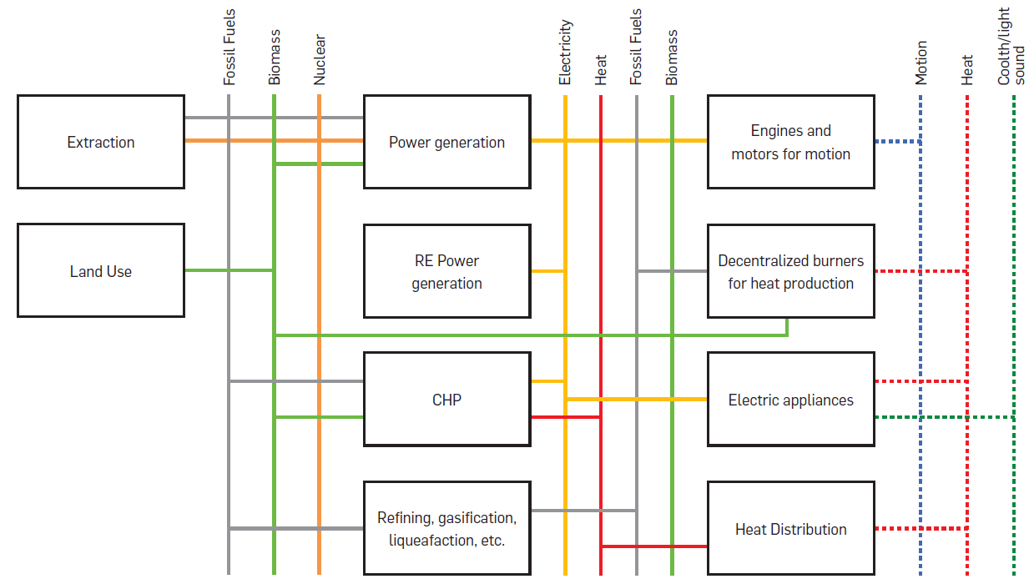
Energy module
Source: M. Weirich (2013). “Global Resource Modelling of the Climate, Land, energy and Water (CLEWS) Nexus Using the Open Source Energy Modelling System (OSEMOSYS).” Internship Report – ME3 2011-2013.

Slide 10
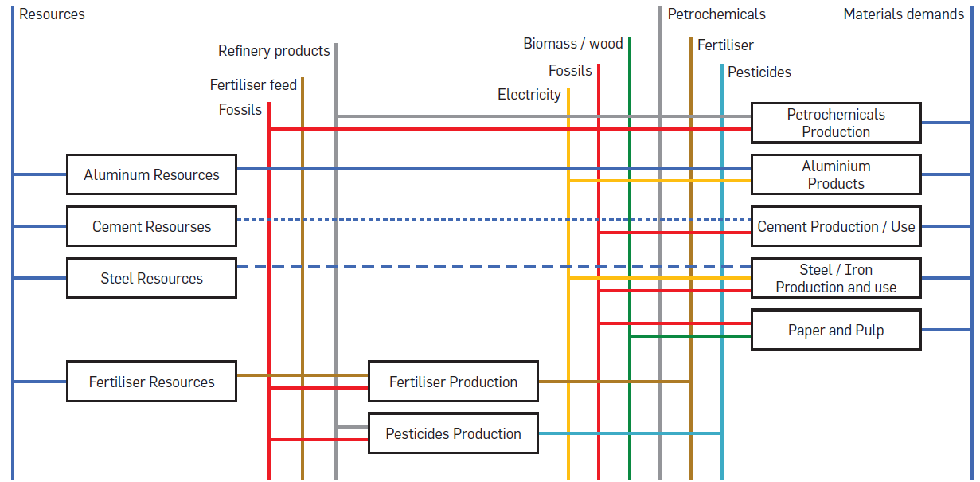
Materials module
Source: M. Weirich (2013). “Global Resource Modelling of the Climate, Land, energy and Water (CLEWS) Nexus Using the Open Source Energy Modelling System (OSEMOSYS).” Internship Report – ME3 2011-2013.

Slide 11
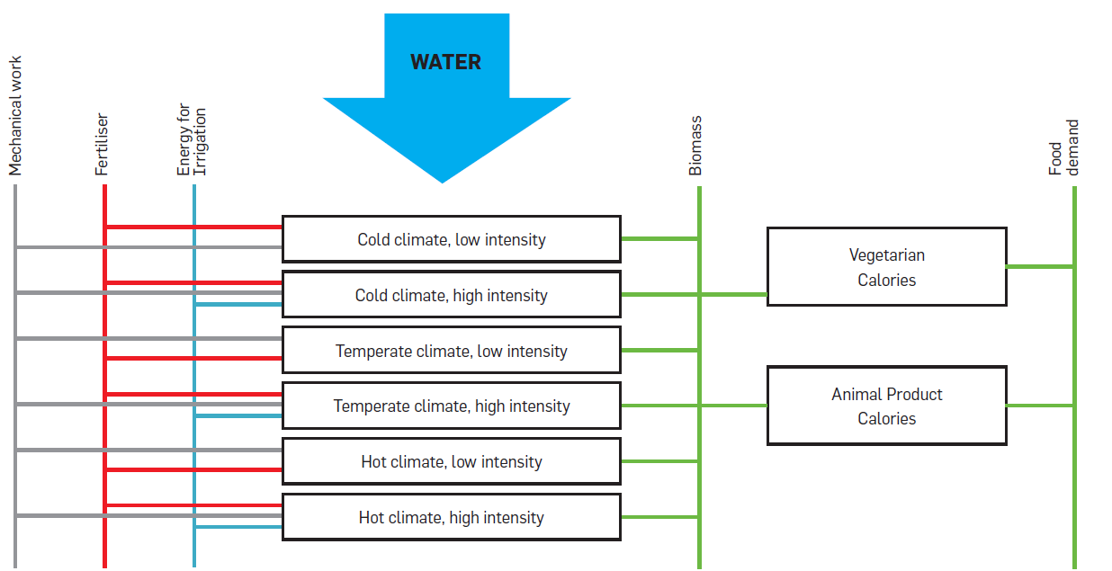
Land module
Source: M. Weirich (2013). “Global Resource Modelling of the Climate, Land, energy and Water (CLEWS) Nexus Using the Open Source Energy Modelling System (OSEMOSYS).” Internship Report – ME3 2011-2013.

Slide 12



Linking the global CLEWS and the2030 Agenda Scheduled additions to the global CLEWS
Housing (rural and urban)
Increased income, energy use and material consumption
Growth scenarios
Demand for food
Demand and source of energy
Industrial production
Assess alternative technologies and consumption patterns
Demand for clean water
Technology and investment options
Accounts for carbon emissions
Deforestation and land use

